Slide 1
Lecture 4: romantic love and courtship
SC22o5: Sociology of the family

Slide 2
Announcement
For Weeks 5 and 6, discussion group sessions will include library sessions
Discussion group sessions will take place in the regular venues before students adjourn for the library sessions
Friday 11 September is a public holiday
Students in D2 may join any of the other discussion group sessions

Slide 3
Announcement
D1 | 8 September | 2.30pm – 3.30pm | Central Library Training Room
D3 | 9 September | 2.30pm – 3.30pm | Central Library Theatrette 2 (Students to bring their own laptops)
E1 | 15 September | 2.30pm – 3.30pm | Central Library Training Room
E2 | 18 September | 12.30pm – 1.30pm | Central Library Training Room
E3 | 16 September | 2.30pm – 3.30pm | Central Library Training Room

Slide 4
Where we have been…
Introduction to sociology of the family
Family as a social construct
Normal family ideology
Conceptual frameworks in the analysis of the family

Slide 5
Where we are going…
Family Formation, Transitions, and Dissolution
Romantic love and courtship
Marriage and cohabitation
Gender and the division of labor
Parenthood
Divorce

Slide 6
In this lecture…
Romantic love and courtship
Cultural prominence of intimacy
Sexuality
Theories of attraction and relationship development

Slide 7
Cultural prominence of intimacy

Slide 8
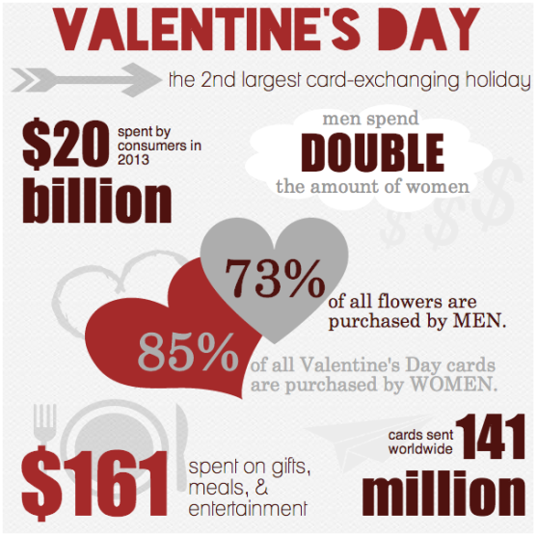
intimacy
The state of being emotionally and affectionately close to another individual

Slide 9
Cultural variations in romantic love
Is romantic love a universal emotion? Do long terms relationships require it?
For most of human history, love had little to do with marriage (Coontz 2005)
The presence and importance of romantic love determined by the broader values and traditions of a given culture
Individualist societies (for example, the United States) versus collectivist societies (for example, India and Pakistan)
Notes:
Love and relationship are constructed in own ways.
Love- fragile and irrational emotions versus marriage
86%- America – would not marry for non-love but man with good qualities.
75%- Pakistan - would marry for a non-love but good man

Slide 10

Feminization of love
Do men and women in the same society differ in their experiences with and expressions of love?
Feminization of love
The process by which love comes to be culturally defined in terms of feminine characteristics such as emotional expression, talking about feelings, vulnerability, warmth, and affection
The reinforcement of men’s power of women
Notes:
Love is weak, and those who need it is came across as being in need of affection.
Thus reinforces men’s power of women in terms of women being the one in need of love and men being the one who will give.

Slide 11
Sexuality

Slide 12
Biology of sexuality
Humans
Nonhuman mammals
Regularly engage in sexual acts at times when conception is not possible and/or not desired
Advanced cognitive abilities enable sexual arousal by mental imagery, written description, or sound of lover’s voice
No sexual behavior during most of the year
Mating only occurs when the male and female are fertile
Such activity leads to pregnancy

Slide 13
Culture and sexuality
Diversity in cultural rules and expectations regarding sexuality- which behaviors are normal and which are abnormal.
Acceptability of heterosexual relations outside of marriage
Cultural determination of sexual dysfunction
Hypoactive sexual desire disorder
Compulsive sexual behavior
What do “too little” or “too much” sexual desire mean?
Notes:
Extends beyond biology and largely depend on biology- what we are expected to do and what is allowed.

Slide 14
Sexual orientation
Compulsory heterosexuality
A characteristic of culture wherein heterosexuality is accepted as the normal, taken-for-granted mode of sexual expression
Heterosexuals are socially privileged as their relationships are affirmed in every facet of culture
The assumption that homosexuality is a preference
- Older studies suggest that homosexuals can be converted back; churches even have programs for this.
Notes:
At a institutional and cultural level, heterosexuality is a norm and expected behavior.

Slide 15
Biological influences on sexual orientation
Sexual orientation as genetically determined?
For example, male fruit flies
However, a single gene unlikely to be responsible for any complex human trait
Studies so far examine the origins of one type of sexual orientation rather than the origins of sexual orientation
Notes:
Gene was inserted in male fruit flies, then they were showing courtships behaviors to other male fruit files.
Autopsies on man and women who are homosexuals, some parts of the brain are substantially smaller in gay man then straight men, and could be a cause of such sexual orientation. (Studies was done on HIV man and women so unreliable data)

Slide 16
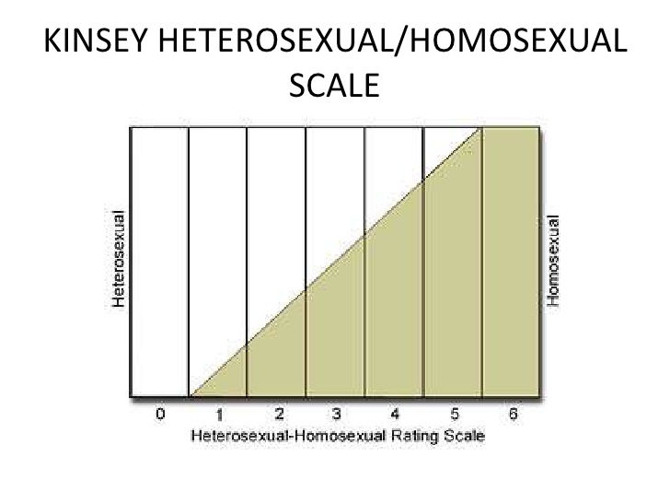
cultural influences on sexual orientation
Heterosexual and homosexual as mutually exclusive categories?
Alfred Kinsey
Sexual orientation lies along a continuum

Slide 17
Biology or culture – does it matter?
What if sexual orientation is biologically determined? What would be the social implications?
Would it make society more open-minded and protective of the civil rights of gay, lesbian, and bisexual individuals?
Would society be encouraged to manipulate biological causes and adapt them to prevailing social norms?
Notes:
Uproar when someone suggested that tests can be developed to find out the sexuality and prevent people from developing homosexuality behaviors

Slide 18
Gender and sexuality
Men represented as having a preference for recreational sex
Sexual pleasure for its own sake
Women represented as having a preference for relational sex
Sex within the context of an ongoing relationship
Sexual double standard
A cultural belief that celebrates men who have lots of sex while punishing women for the same behavior
Impact on beliefs and attitudes
“Madonna Whore complex” – sexy but confident with sexuality but must be pure and never have sex before.
Notes:
Men are more likely to engage in recreational sex when they do not have relational sex.
Women who openly have sex talks- negativity
Men who brings contraceptives to a date is deemed as trustworthy but women who do is think of negatively.

Slide 19
Theories of attraction and relationship development

Slide 20
Sociobiological model of attraction
All species must evolve efficient ways to pass on their genetic material through successful reproduction
Parental investment
The relative contribution fathers and mothers make to the genetic fitness of their offspring
To maximize the chances of species survival, men and women have evolved different mate selection strategies based on biological differences in the reproductive process
Notes:
Different animals have different parental investments; eg. Eggs bore by female fishes are fertilized by sperms from male fishes, hardly require both of them to be in a relationship.
Human females make a big investment in the process.

Slide 21
Sociobiological model of attraction
Task | Average Female Investment | Average Male Investment
Sexual Intercourse | 2 minutes to 2 hours | 2 minutes to 2 hours
Pregnancy | 9 months (1-2 months inhibited activity) | Not applicable
Lactation and Childcare | 0 months to 4 years | Variable and flexible
Total Investment | 43,202 minutes to 2,188,920 minutes per child | 2 minutes to 120 minutes per child

Slide 22
Sociobiological model of attraction
Women’s high reproductive investment = preference for relational sex
Men’s low reproductive investment = preference for recreational sex
Notes:
Sociobiologist.
Women like feminist man usually, but when they are ovulating they prefer someone who is more ragged (goes back to the hunter and gather society)

Slide 23
Sociobiological model of attraction
Men and women are genetically programmed to desire different traits
Women’s need for protection and stability helped them evolve a preference for mates capable of acquiring resources, and willing and able to support and protect their children
Men are attracted to women who show visible signs of fertility: physical attractiveness, health, and youth

Slide 24
Sociobiological model of attraction
Do sexual tendencies stem exclusively or even primarily from biological imperatives?
Historically, laws and norms were designed to protect men’s property, including women
Men’s and women’s preferences have changed over time (Carbone and Cahn 2014)
Notes:
Women’s movement was restricted so that children are known to be by the males, and properties can be passed on to the offspring.
Men also wants women with good career prospects, and women’s prospects have changed due to economic independence.

Slide 25
The social exchange model
Why are we attracted to some individuals and not others? why do we pursue some relationships and avoid others?
Intimate relationships provide rewards but present costs as well
Focus on the cultural capital individuals have at their disposal and the demands of the relationships marketplace
Relationships develop when the arrangement is mutually beneficial to the parties
Notes:
Both bring their strengths into the relationship

Slide 26
The social exchange model
Expectations
For example, if a woman receives certain necessary resources from her abusive partner and feels that she cannot get those resources elsewhere, she may stay in the relationship out of necessity
Notes:
Calculates the ratio of rewards and cost.

Slide 27
The social exchange model
Availability of partners
Relationship opportunities vary by age, education, geographic location, race, and social class (Carbone and Cahn 2014)
Marriage rates can also be affected by the overall supply of men and women of marriageable age with desirable economic and social characteristics
Notes:
One child policy in China has led to overwhelming amount of men opposed to women, and women thus have more bargaining power because there is less of women. Studies have shown that people would rather not get married then lower their marriage conditions.

Slide 28
Summary
The role that love plays in our intimate lives is determined by the nature of the culture in which we live
In our society, love has become a “feminized” emotion
Human sexuality is more than just a biological drive; its expression is subject to strong societal norms
Attempts to identify the biological basis of our intimate relationships remain controversial
The social exchange model attempts to explain how individuals become attracted to each other and why they stay together; relationships are influenced by expectations and availability

